Slide 1
Algoritma & Pemrograman
Functions (2)
Prepared by
Frans Panduwinata, S.Kom, M.T

Slide 2
Jumping to Sub-Routines
When a function is called, the program jumps to a sub-routine.
All this jumping back and forth can affect the run time of your program, especially if the function contains only a few instructions and is called quite often.
The time taken to branch to a small function can be greater than the time needed to execute the function itself.

Slide 3
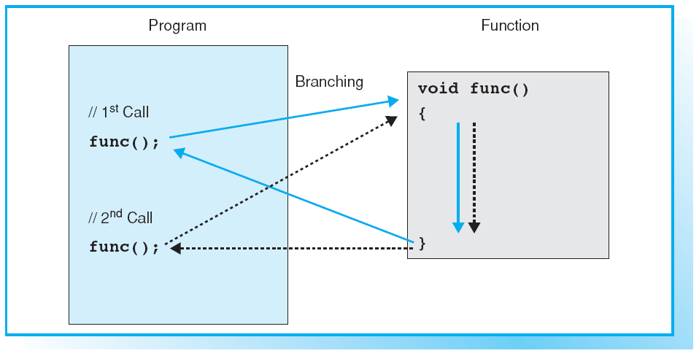
Jumping to Sub-Routines (cont)

Slide 4
Inline Definition
The compiler inserts the code of an inline function at the address where the function is called and thus avoids jumping to a sub-routine.
The definition of an inline function is introduced by the inline keyword in the function header.
EXAMPLE:
inline int max( int x, int y)
{ return (x >= y ? x : y ); }

Slide 5
Inline Definition (cont)
The program code will expand each time an inline function is called.
This is why inline functions should contain no more than one or two instructions.
If an inline function contains too many instructions, the compiler may ignore the inline keyword and issue a warning.
An inline function must be defined in the source file in which it is called.
Define inline functions in header files, in contrast to “normal” functions.

Slide 6
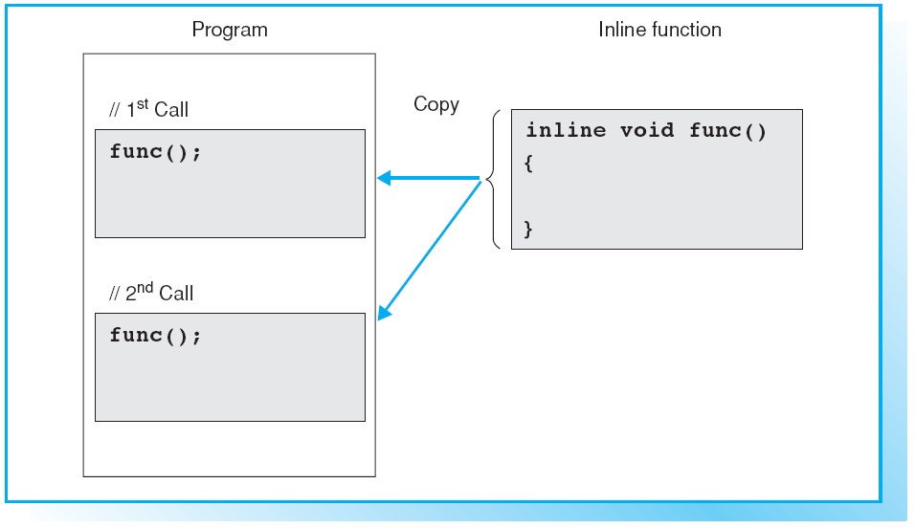
Call to an Inline Function

Slide 7
Inline Functions and Macros
Inline functions are an alternative to macros with parameters.
When a macro is called, the preprocessor simply replaces a block of text.
In contrast, an inline function behaves like a normal function, although the program flow is not interrupted by the function branching.

Slide 8
Defining Default Arguments
The default values of a function’s arguments must be known when the function is called.
EXAMPLE:
void moveTo( int x = 0, int y = 0); OR
void moveTo( int = 0, int = 0);
The function moveTo() can then be called with or without one or two arguments.
moveTo (); moveTo (24); moveTo(24, 50);
The first two calls are equivalent to moveTo(0,0); or moveTo(24,0);

Slide 9
Possible Calls
When calling a function with default arguments you should pay attention to the following points:
  You must first supply any arguments that do not have default values.
  You can supply arguments to replace the defaults.
  If you omit an argument, you must also omit any following arguments.

Slide 10
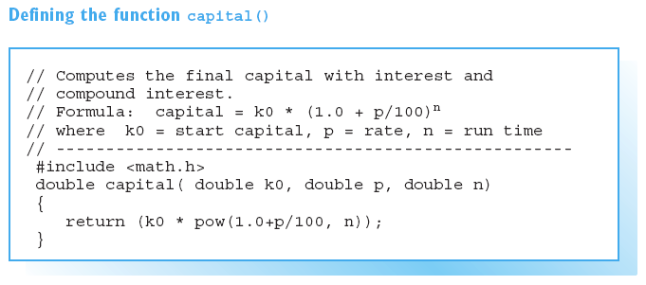
Sample Program

Slide 11
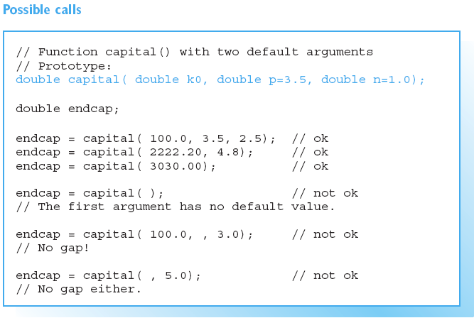
Sample Program (cont)

Slide 12
Overloading
C++ allows you to overload functions, that is, different functions can have the same name.
EXAMPLE:
int max( int x, int y);
double max( double x, double y);
The function max() was overloaded for int and double types.
The compiler uses a function’s signature to differentiate between overloaded functions.

Slide 13
Function Signatures
A function signature comprises the number and type of parameters.
When a function is called, the compiler compares the arguments to the signature of the overloaded functions and simply calls the appropriate function.
EXAMPLE:
double maxvalue, value = 7.9;
maxvalue = max( 1.0, value);
In this case the double version of the function max() is called.

Slide 14
Function Signatures (cont)
When overloaded functions are called, implicit type conversion takes place.
However, this can lead to ambiguities, which in turn cause a compiler error to be issued.
EXAMPLE:
maxvalue = max( 1, value); // Error!
The signature does not contain the function type, since you cannot deduce the type by calling a function.

Slide 15
Function Signatures (cont)
It is therefore impossible to differentiate between overloaded functions by type.
EXAMPLE :
int search(string key);
string search(string name);
Both functions have the same signature and cannot be overloaded.

Slide 16
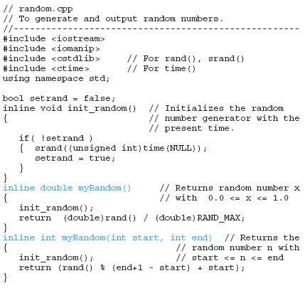
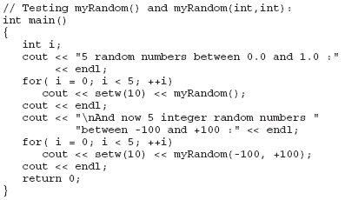

Sample Program
Screen Output:

Slide 17
Recursion
A function that calls itself is said to be recursive.
This process can also be performed indirectly if the function first calls another function or multiple functions before it is called once more.
A break criterion is always necessary to avoid having the function call itself infinitely.
Recursion requires local objects to be created each time the function is called, and these objects must not have access to any other local objects from other function calls.

Slide 18
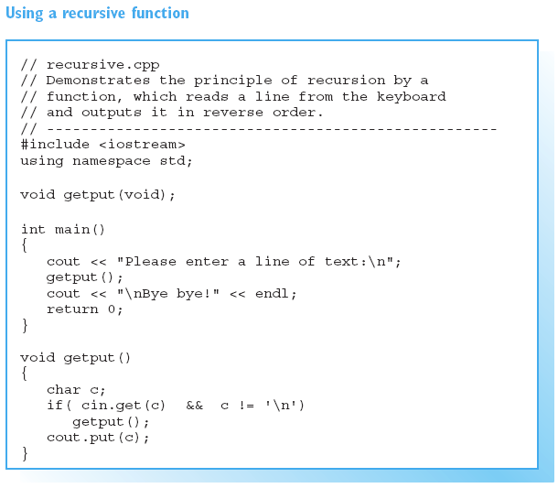

Recursion (cont)
Screen Output:

Slide 19
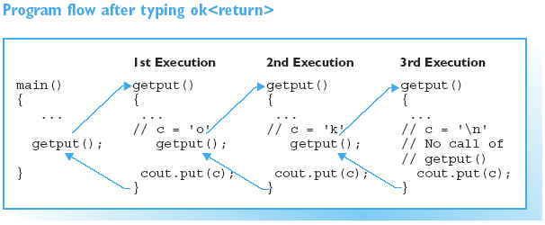
Recursion (cont)

Slide 20
Practical Usage
The logic of various solutions to common problems results in a recursive structure.
For EXAMPLE,
  Browsing directory trees,
  Using binary trees for data management, or
  Some sorting algorithms, such as the quick sort algorithm.
Recursive functions allow you to formulate this kind of logic in an efficient and elegant manner.

Slide 21
Macros
C++ has a simple mechanism for defining macros. You simply use the preprocessor’s #define directive.
SYNTAX:
#define name substitutetext
  This defines a macro called name.
  The preprocessor replaces name with substitutetext throughout the subsequent program.

Slide 22
Macros (cont)
There is one exception to this general rule: substitution does not take place within strings.
For EXAMPLE, the statement
cout << "PI";
outputs only PI and not the numerical value of PI.

Slide 23
Symbolic Constants
Macros that are replaced by constants, such as the PI macro, are also known as symbolic constants.
Note that neither an equals sign nor a semicolon is used, as these would become part of the substitute text.
You can use any macros you have previously defined in subsequent #define directives.

Slide 24
More about Working with Macros
Using macros makes a C++ program more transparent and flexible.
There are two main advantages:
  Good readability
  You can name a macro to indicate the use of the macro
  Easy to modify
  If you need to change the value of a constant throughout a program, you simply change the value of the symbolic constant in the #define directive.

Slide 25
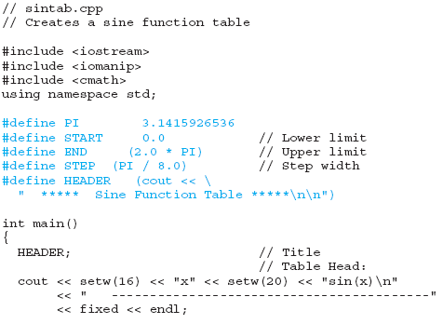
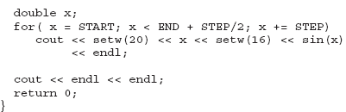
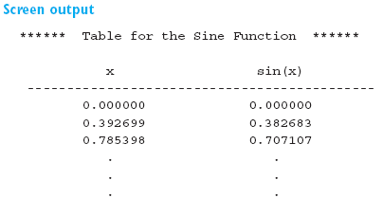
Sample Program

Slide 26
Macros with Parameters
It is possible to call macros with arguments.
EXAMPLE:
#define SQUARE(a) ((a) * (a))
  When the macro is called, for example
z = SQUARE(x+1);
  This example also shows that you must be careful when using brackets to indicate parameters for macros.
  Omitting the brackets in the previous example, SQUARE, would cause the expression to be expanded as follows
z = x + 1 * x + 1.

Slide 27
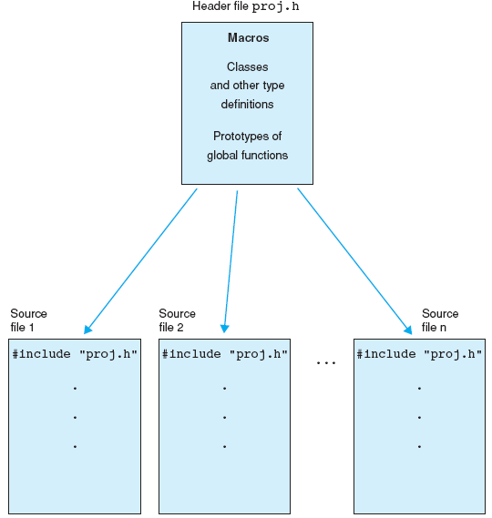
Using Macros in Different Source Files

Slide 28
Macros vs Functions
Macros
A macro definition must be visible to the compiler.
The substitute text is inserted and re-compiled each time the macro is called.
The speed of program execution will, however, improve since the program does not need to branch to sub-routines in contrast to normal function calls.
Functions
Functions are compiled independently.
The linker then links them into the executable file.
The program branches to the function whenever it is called, and this can reduce the speed of execution in comparison to a macro.

Slide 29
Macros vs Functions
Macros
Side effects of macros are possible if the substitute text contains multiple instances of a parameter.
EXAMPLE
  The statement SQUARE( ++x ) expands to ((++x) * (++x)).
  The variable x is incremented twice and the product does not represent the square of the incremented number.
Functions
The compiler checks the argument types, and the side effects seen with macros cannot occur.

Slide 30
Case Conversion
The macro toupper is used to convert lowercase letters to uppercase.
If c1 and c2 are variables of type char or int where c1 contains the code for a lowercase letter, you can use the following statement
EXAMPLE:
c2 = toupper(c1);
if c1 is not a lowercase letter, toupper(c1) returns the character “as is.”

Slide 31
Testing Characters
A number of macros, all of which begin with is..., are available for classifying characters.
EXAMPLE:
char c; cin >> c; // Reads and
// classifies
if( !isdigit(c) ) // a character.
cout << "The character is no digit \n";

Slide 32
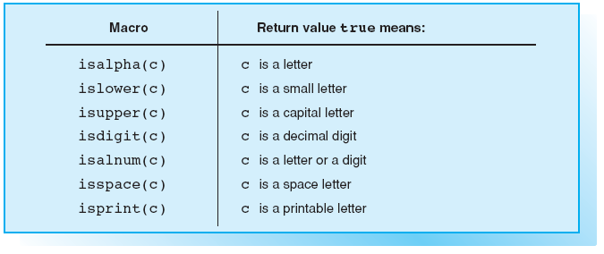
Macros for Character Classification

Slide 33
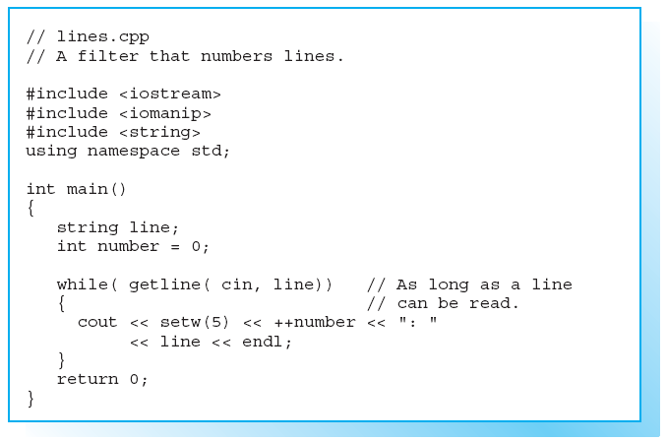
Sample Program

Slide 34
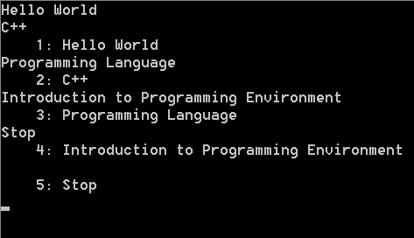
Sample Program (cont)
Screen Output:

Slide 35
Redirecting Standard Input and Output
Call the previous program
  Redirecting the standard input:
lines < text.dat | more
This outputs the text file text.dat with line numbers.

Slide 36
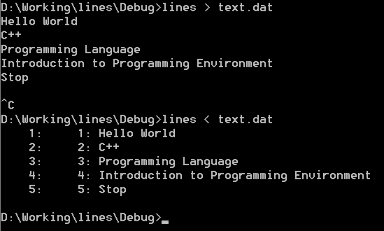
Redirecting Standard Input and Output (cont)
Call the previous program (cont)
  Redirecting the standard output:
lines > new.dat
Here the program reads from
the keyboard and adds the
output to the new file new.dat.
Please note, if the file already
exists, it will be overwritten!
Type Ctrl+c (DOS) or Ctrl+D
(UNIX) to TERMINATE
keyboard input.

Slide 37
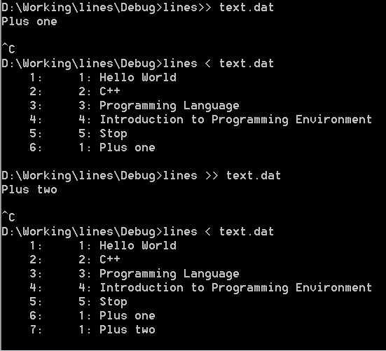
Redirecting Standard Input and Output (cont)
Call the previous program (cont)
Use lines >> text.dat
to append program output to
the file text.dat.
If the file text.dat does not
already exist, it will be created.

Slide 38
Filter Programs
The program which
READS characters from standard INPUT,
PROCESSES them, and
SENDS them to standard OUTPUT are known as
FILTERS.

Slide 39
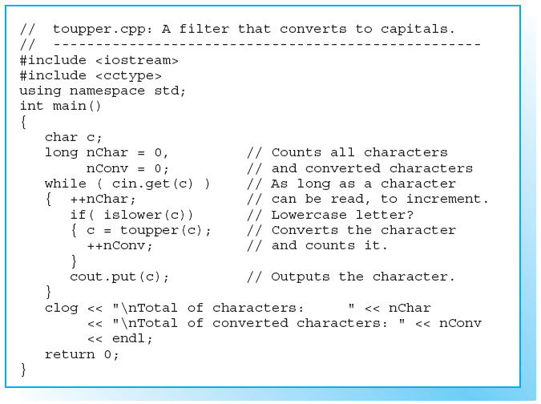
Filter Programs (cont)

Slide 40
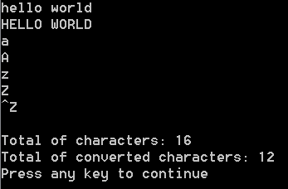
Filter Programs (cont)
Screen Output:

Slide 41
Using Filter Programs
Filter programs are extremely useful since various operating systems, such as DOS, Win**, WinNT, and UNIX are capable of redirecting standard input and output.
This allows easy data manipulation.
EXAMPLE:
lines < text.dat
This syntax causes the program to read data from a file instead of from the keyboard.

Slide 42
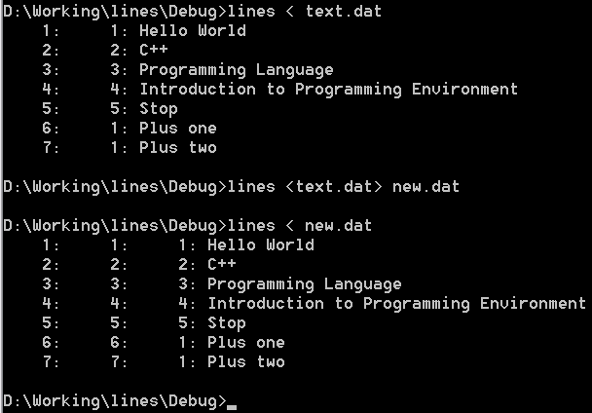
Using Filter Programs (cont)
This allows easy data manipulation (cont).
EXAMPLE:
lines < text.dat > new.dat
In this example the contents of
text.dat and the line numbers
are stored in new.dat.
The program does not generate
any screen output.

Slide 43
Exercises
EXERCISE 1
The factorial n! of a positive integer n is defined as
n! = 1*2*3 . . . * (n-1) * n Where 0! = 1
Write a function to calculate the factorial of a number.
  Argument: A number n of type unsigned int.
  Returns: The factorial n! of type long double.
Formulate two versions of the function, where the factorial is
  calculated using a loop
  calculated recursively
Test both functions by outputting the factorials of the numbers 0 to 20.

Slide 44
Exercises (cont)
EXERCISE 2
Write a function pow(double base, int exp) to calculate integral powers of floating-point numbers.
  Arguments: The base of type double and the exponent of type int.
  Returns: The power base^{exp} of type double.
For EXAMPLE, calling pow(2.5, 3) returns the value
2.5³ = 2.5 * 2.5 * 2.5 = 15.625
This definition of the function pow()means overloading the standard function pow(), which is called with two double values.
Test your function by reading one value each for the base and the exponent from the keyboard and compare the result of your function with the result of the standard function.

Slide 45
Exercises (cont)
EXERCISE 3
Write a function named even_odd which required one parameter, type int, and has a return value of 0 (for even) or 1(for odd).
Write a print_data function to print output program.
Write a program to show an input number (integral type) is either even or odd. Sample output:
Input number: 25
25 is an odd number
Input another number?(y/n)

Slide 46
Assignment
Create a program for sorting (Selection or Insertion) a list of positive integers using 2 dimensional arrays (max: 10x10) and functions
Show information for sorting process step by step
Make a presentation with description of sorting and step by step process of sorting sample
Assignment due: 2 weeks from this meeting

